Slide 1
F# SqlClient Not your Grandfather's ORM
Dmitry Morozov
APRL 28, 2015

Slide 2


almost F# full stack software engineering team
We create technology to optimize energy production for the oil and gas industry.
Azure, IOS, Xamarin, WebAPI, Data Science, Machine Learning, Fake, Data Access + TypeScript, Python, Mathematica, Matlab etc

Slide 3
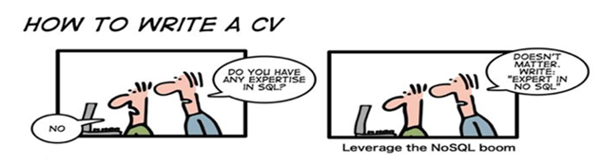
SQL server as storage engine
This is not SQL vs “NoSQL” discussion

Slide 4
Interesting facts from TIOBE Index
T-SQL – "Programming Language of the Year“ in 2013
The award is given to the programming language that has the highest rise in ratings in a year.
F# - number 14 as of today. Moved up a lot since July 2013
Both are doing fairly well

Slide 5

If both are so good LET’S JUST ADD them UP WHAT POSSIBLY CAN GO WRONG ?

Slide 6

The Vietnam of Computer Science
ORM, ENTITY FRAMEWORK ☹

Slide 7
3 THINGS DEVELOPERS CARE ABOUT
PRODUCTIVITY
SAFETY
CONTROL

Slide 8

T-SQL DATA ACCESS OPTIONS for F# developers
 | Productivity | Safety | Control
ADO.NET | ? | ? | ?
ORM – EF, NHibernate | ? | ? | ?
Light ORM - Dapper | ? | ? | ?
F# SQLProvider | ? | ? | ?
???

Slide 9
SqlCommandProvider
SqlProgrammabilityProvider
SqlEnumProvider

Slide 10
Productivity
Static types + intellisense for:
Input parameters
Output rowset
T-SQL syntax errors at runtime !!!
Simple connection management – it just works
T-SQL intellisense in external files

Slide 11

safety

Slide 12
safety
Statically typed input parameters
SQL injection attacks are no possible
Option<_> type for nullable output columns
No NullReferenceException
Safe deployment to production environment
Queries are always up to date with a schema

Slide 13
CONTROL
WYSIWYG T-SQL development (design time T-SQL = run-time T-SQL)
Performance as if you wrote low level ADO.NET code
Access to full set of the latest T-SQL (spatial types, TVP, window functions, etc.)
Numerous configuration options
Inline or file-based queries
AsyncExecute for scalable servers, non-blocking UI. (including .NET 4.0)
*.config files support
Runtime connection configuration – IOC
Transactions
Different output types – Record (default), Tuples , DataTable, DataReader
Singletons – SingleRow = true

Slide 14
Best of both worlds
F#
Type safety
Developer-friendly tools
Productivity
T-SQL
Set-based logic
Industry expertise
Tools (profiling, monitoring, etc.)
Azure
Predictable runtime performance

Slide 15
SqlProgrammabilityProvider or How to keep your “waterfall” DBA happy
First class access to SQL Server objects
Stored procedures
Functions (table-valued and scalar)
Tables
Support for stored procedure parameter default value
Table type with Bulk Insert and Update support

Slide 16
SqlEnumProvider
Enumeration for database static lookups

Slide 17
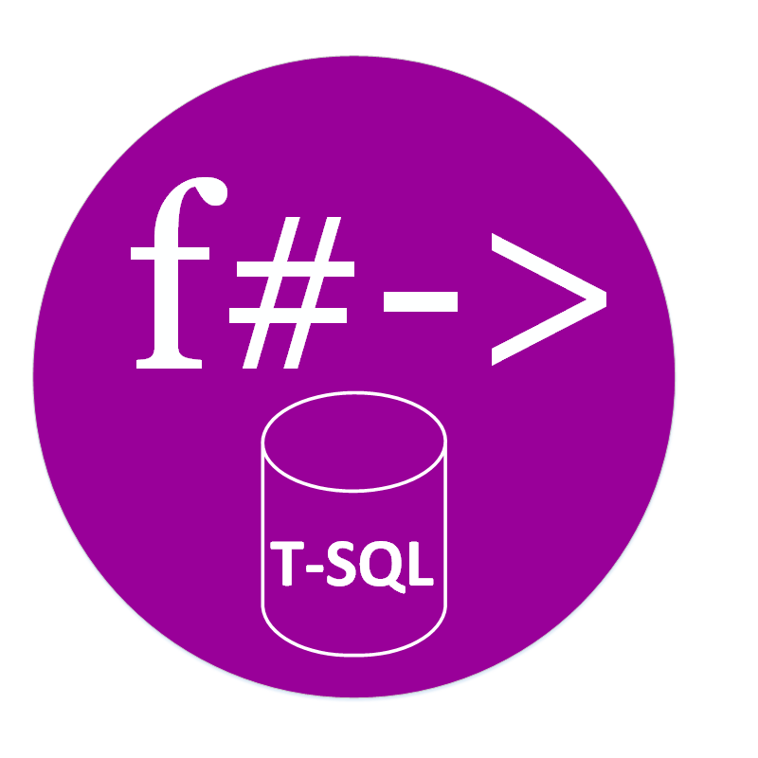
SUMMARY
Data access in T-SQL can be pleasant exercise
http://fsprojects.github.io/FSharp.Data.SqlClient/
Quite good docs and sample projects
Follows F# OSS standards

